Slide 1
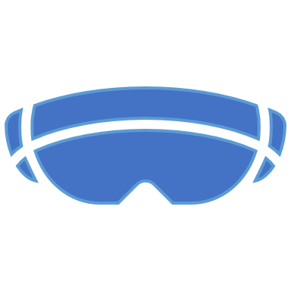
Cloud VR – Distributed VR Solutions
By Leon Koster

Slide 2
Problem Statement + Context
Recent developments in the field of VR offer all kinds of opportunities in the field of training and entertainment. For training purposes, the audiovisual entry into a virtual world is where the biggest value is. The capabilities of artificial environments allow users to manage scenarios and experiences that cannot be simulated in the real world. VR also allows users to access the virtual training at any time and less physical facilities are required for exercises.
Current VR experiences have two major flaws:
VR needs a powerful computer. These set ups are not available everywhere and are difficult to move.
For rendering the scenario, confidential data needs to be available on the computer.

Slide 3
Goals
Stream VR applications from the cloud in a fast and save manner:
Low Latency
High Security
Good user experience (mainly facilitated through low latency)

Slide 4
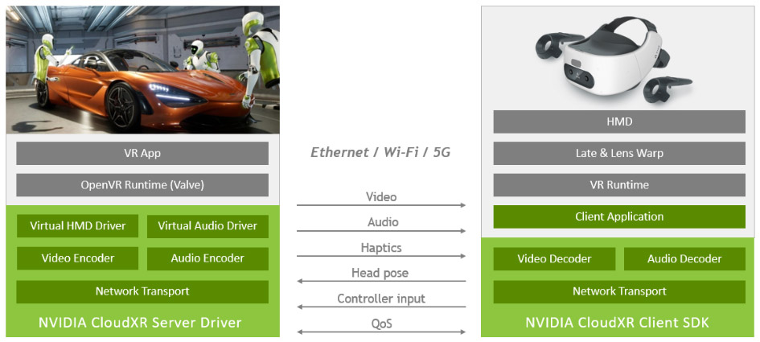
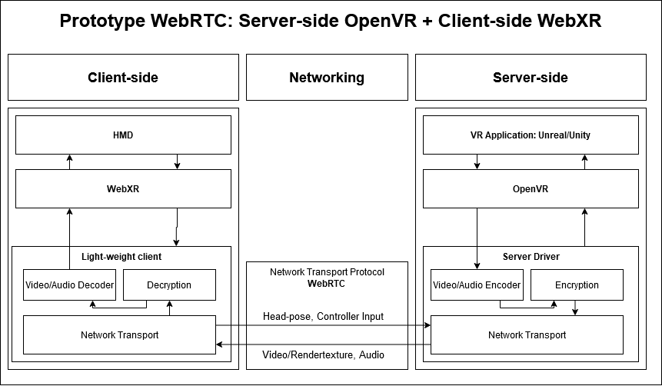
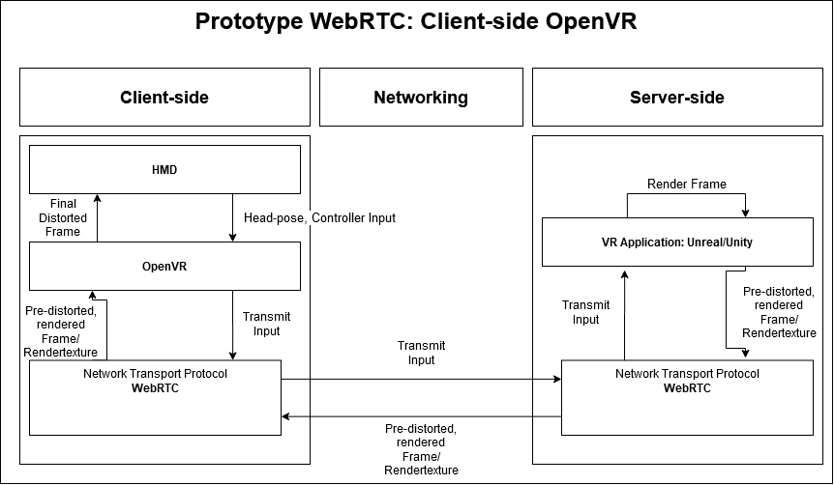
Early Research
Identified measurable metrics to judge latency and user experience:
Motion-to-Photon latency
Reading research papers about potential solutions.
Identifying possible tech stacks:

Slide 5
Choosing a Tech Stack
In the end NVIDIA CloudXR SDK was chosen as the tech stack to go forward with based on two observations:
CXR is the only solution that is proven to work
It would require more time than I had to make the other two prototype suggestions work

Slide 6
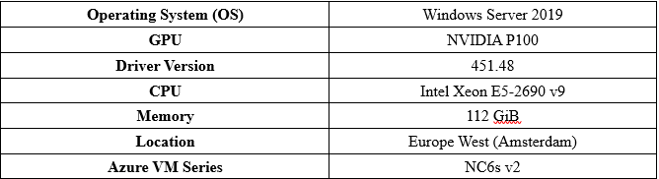
Implementation 1
Due to Thales request, the prototype would be set up in the Dutch secure defense cloud powered by Microsoft Azure.
There were a lot of challenges throughout the implementation process:
This project was the first time anyone has ever tried to set up CXR in an Azure environment.
This project was essentially a cooperation between 4 institutions: Saxion, Thales, NVIDIA and Microsoft.
Initially the prototype performed very bad, to the point it was unusable. However it was not immediately clear why.
This project started right as the pandemic escalated, so it was a bit harder than normal to keep up communications, since physical meetings were impossible/rare.

Slide 7
Implementation 2
Together with support engineers from Microsoft Azure and NVIDIA I debugged the performance problems on the prototype. The results:
Windows 10 Pro caused a performance issue. The solution was to use Windows Server 2019. The cause of this remains unknown
It is important to install game-ready drivers. The default driver for the P100 GPU is a compute server and as such did no support CXR. The solution was to install a vGPU driver from NVIDIA’s GRID technology.

Slide 8
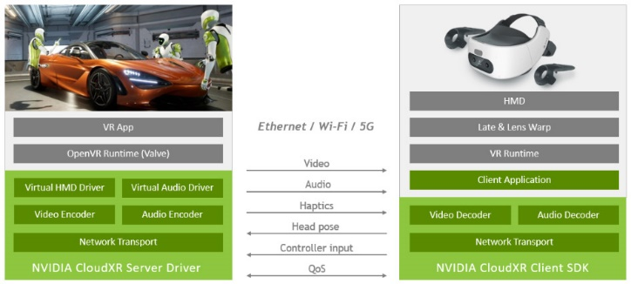

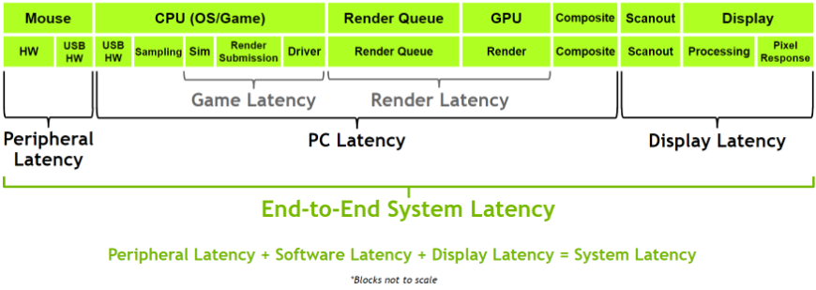
Testing
Together with Thales I came up with tests to measure the performance of the prototype:
End-to-End Latency: This test captures the whole system latency.
Network Latency: This test captures the impact of networking on the End-to-End latency.
CXR Statistics: These are statistics recorded by the CXR software. They give good insight in the performance of the software alone.

Slide 9
Results
E2E latency: 145-150ms -> 50% higher than local VR game (90-100ms)
Network Latency: Round Trip Time = 5-6ms -> ~3.3% of E2E latency and ~26% of individual frame latency
Individual Frame Latency: 21-22ms -> only ~10% higher than 20ms MTP barrier

Slide 10
Conclusion
The final prototype is deployed in the Dutch secure defense cloud and it’s performance is only ~10% over the MTP limit. With this the prototype fulfills the goals (Low Latency, High Security, Good user experience ) defined in the beginning of the project.
The solution is very flexible as it allows for streaming of every OpenVR based application. Initial user testing suggests that the user experience is not at all/barely compromised.

Slide 11
Acknowledgements
I want to take the opportunity to thank several people who made this project possible:
Matthijs van Ween and Saxion
Jeroen van der Wel and Thales
Gregory Jones, Chris Mcleod and NVIDIA
Vincent van Wingerden and Microsoft Azure

Slide 12

Thank you for your attention

